Slide 1
Defensive Security Project
by: Team 9.
Andrea,Antwoine,Chris,Fernando,Martin,Nicholas and Prince.
Notes:
Prince

Slide 2
Table of Contents
This document contains the following resources:
Monitoring Environment
Attack Analysis
Project Summary & Future Mitigations

Slide 3

Monitoring Environment
‹#›

Slide 4
Scenario
VSI, a virtual reality program company, faces potential cyberattacks from JobeCorp.
Tasked with using Splunk to monitor and protect VSI’s systems
Loaded and analyzed Windows logs and created reports, alerts, and dashboards
Monitored Windows server logs for signatures, severity levels, and success/failure rates
Designed reports to identify specific information, such as signatures IDs and severity distribution
Created alerts for failed activities, successful logins, and deleted accounts
Developed visualizations and a dashboard for monitoring Windows server activity

Slide 5
Windows Logs
‹#›
Notes:
Antwoine, Nic

Slide 6
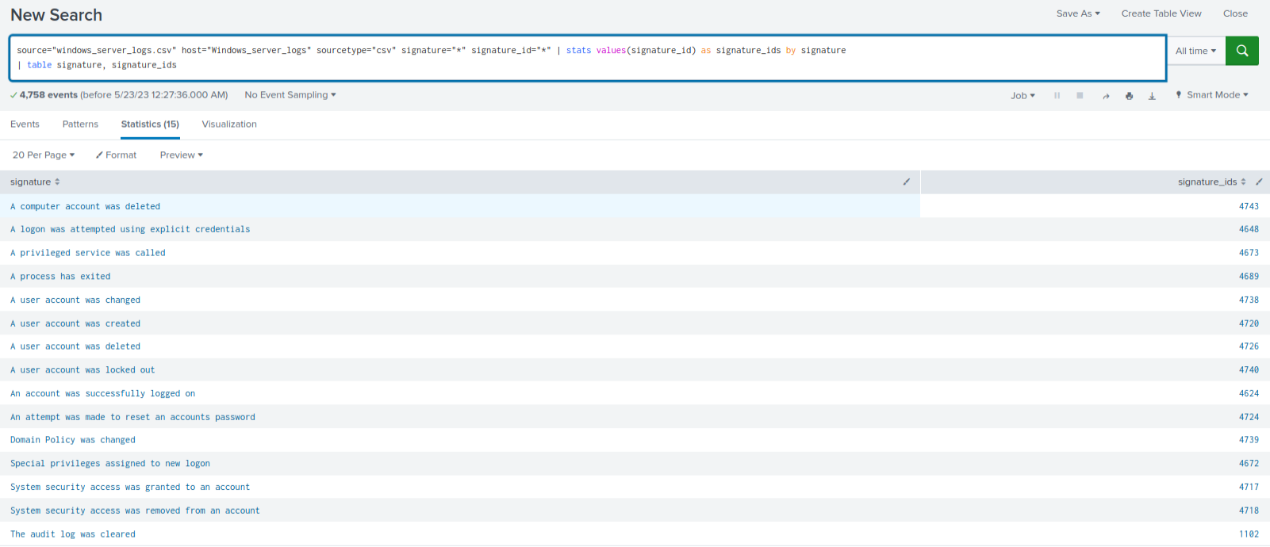
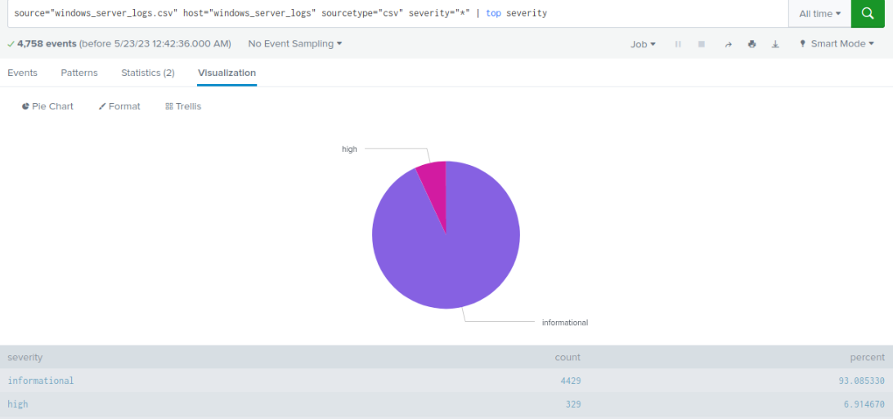
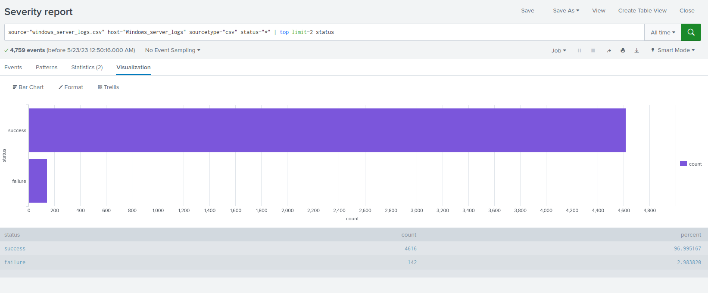
Reports—Windows
Designed the following reports:
Report Name: Signatures and Associated Report Name: Severity Levels and Counts Report Name: Comparison of Windows Activity
Signature IDs Success and Failure
Report Description: Report Description: Report Description: table of signatures and their Displays the severity levels of Windows logs provides a comparison between the success and
associated signature IDs for Windows activity along with their respective counts and percentages failure of Windows activities, enabling VSI to detect
suspicious levels of failures on their server
Notes:
Twon

Slide 7
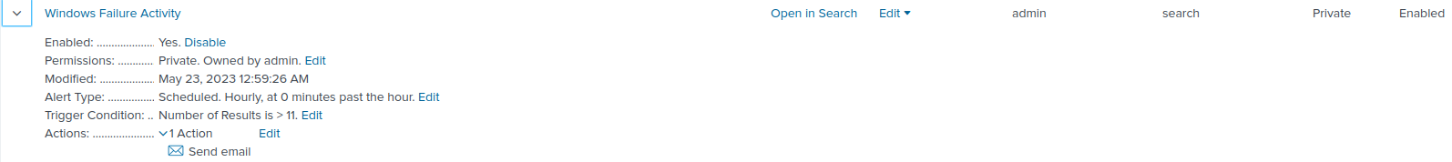
Alerts—Windows
Designed the following alerts:
Alert Name | Alert Description | Alert Baseline | Alert Threshold
-Failed Windows Activity | Monitors hourly level of failed Windows activity Compares activity levels against a baseline Triggers an alert when the threshold is reached | - Average hourly failed activity 7/ past 7 days | Any significant increase above the baseline 11
JUSTIFICATION: it allows VSI to detect and respond to potential security breaches or unauthorized access attempts. Monitoring normal Windows activity, it identifies significant increases in failed activity, indicating potential threats. which leads to an investigation and protection of VSI’s systems
Notes:
Twon

Slide 8
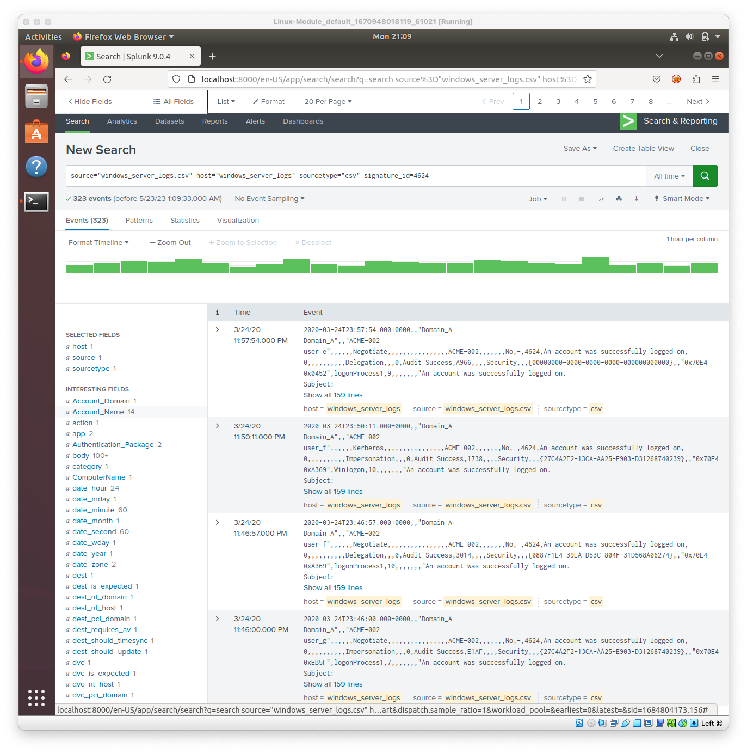
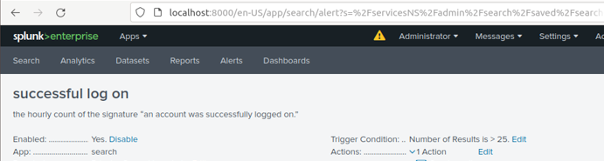
Alerts—Windows Successful log in
Alert Name | Alert Description | Alert Baseline | Alert Threshold
Windows Successful Logins | abnormal successful logins detected, potential breach | Average Baseline 18 | Number of Results is greater than 25
JUSTIFICATION: detects anomalies in the number of successful login attempts, allowing VSI to identify potential unauthorized access and take appropriate security measures Team 9 determined that 25 logins a number slightly larger than than the norm to ensure the prevention of alert fatigue.
Notes:
Nic

Slide 9
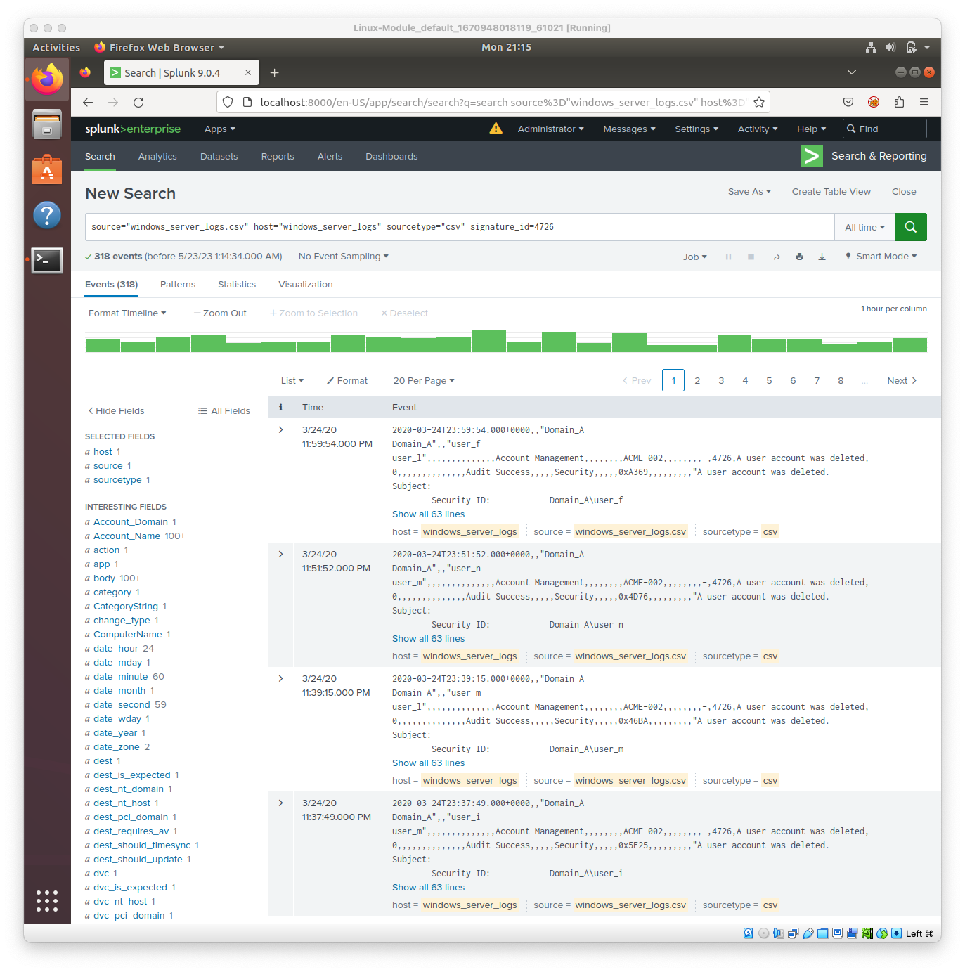
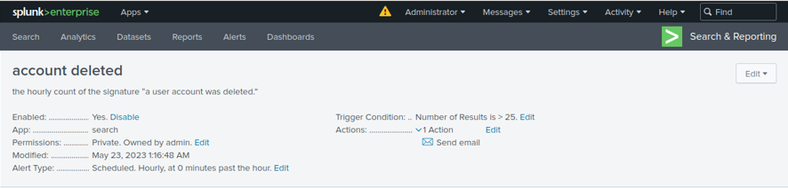
Alerts—Windows Deleted accounts
Alert Name | Alert Description | Alert Baseline | Alert Threshold
Windows Deleted Accounts | Unusual account deletions detected, possible compromise | Average baseline 18 | Number of Results is greater than 25
JUSTIFICATION: identifies variations from the established account deletion patterns, enabling VSI to detect any suspicious or unauthorized account activities and mitigate potential security risks
Team 9 determined that 25 logins a number slightly larger than than the norm to ensure the prevention of alert fatigue.
Notes:
Nic

Slide 10
Apache Logs
‹#›
Notes:
Andrea

Slide 11
Reports—Apache
Designed the following reports:
Report Name | Report Description
HTTP Methods Report | Identifies HTTP activity on the Apache server.
Top 10 Referrer Domain Report | Highlights top 10 domains referring to VSI’s website/ detects suspicious referrers.
HTTP Response Code Report | Identifies HTTP response code patterns.

Slide 12
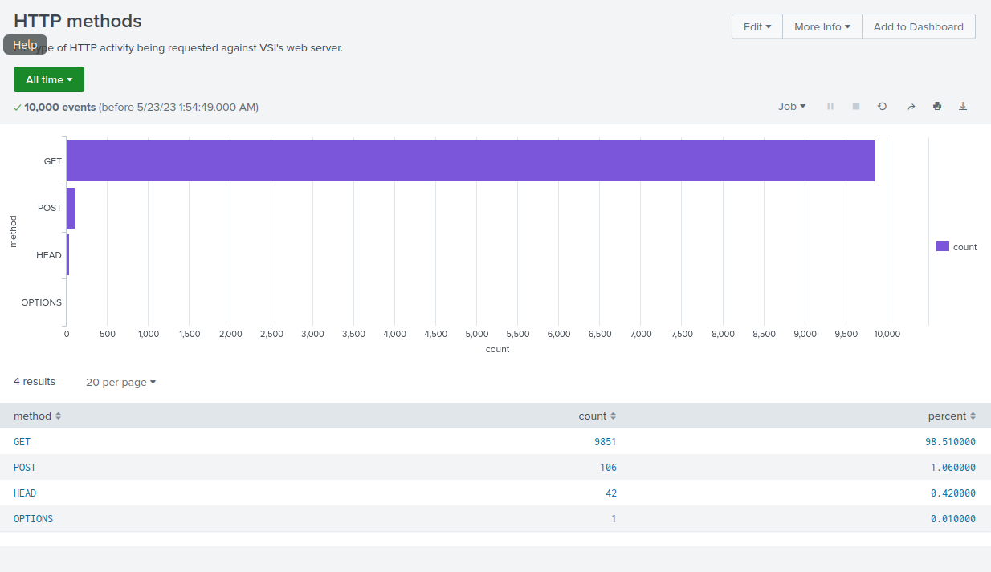
Images of Reports—Apache

Slide 13
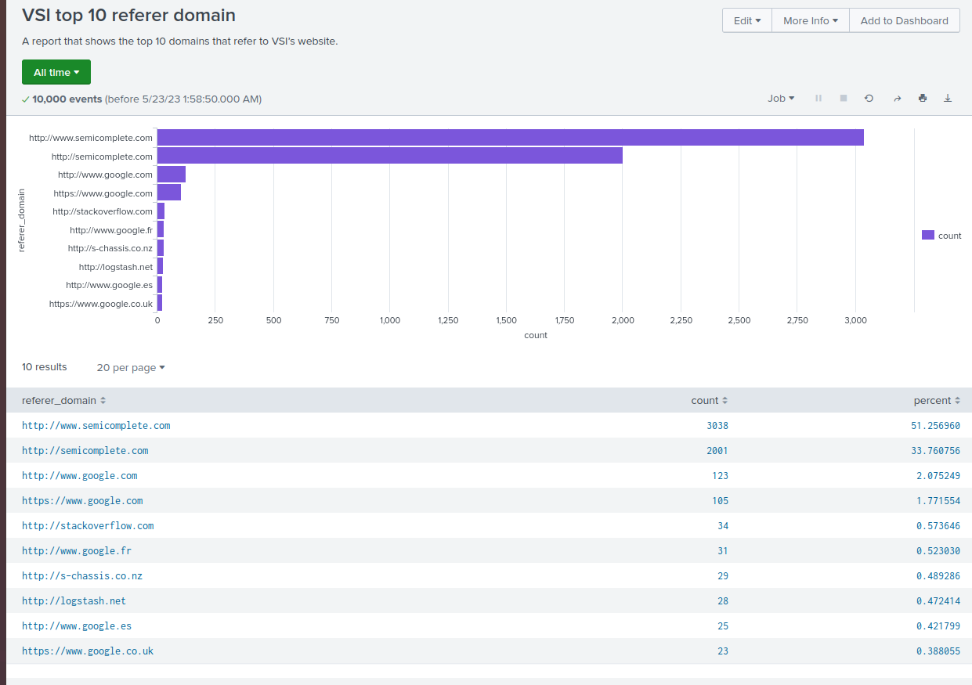
Images of Reports—Apache

Slide 14
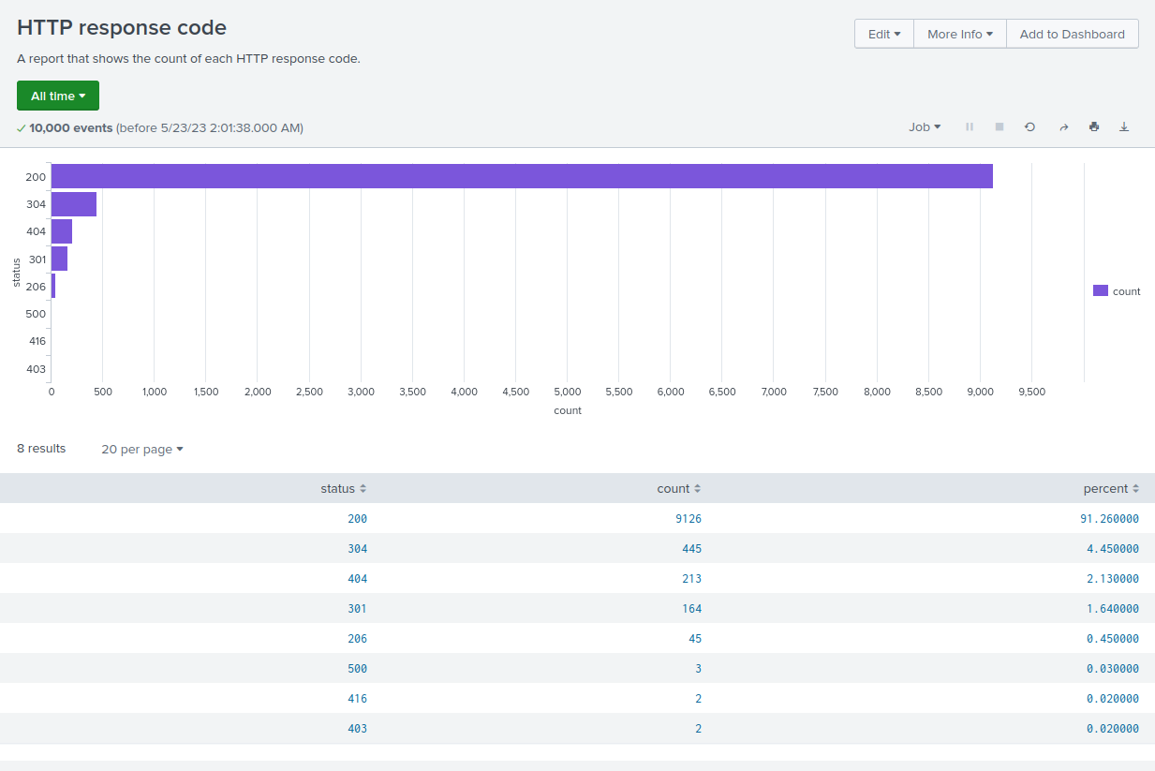
Images of Reports—Apache

Slide 15
Alerts—Apache
Designed the following alerts:
Alert Name | Alert Description | Alert Baseline | Alert Threshold
Activity Outside of US Alert | Monitors non-U.S. countries for suspicious activity | 500 | 900
JUSTIFICATION: actively detects and identifies potential unauthorized access attempts from foreign locations, enabling VSI to respond and mitigate any security risks to their web server environment.

Slide 16
Alerts—Apache
Designed the following alerts:
Alert Name | Alert Description | Alert Baseline | Alert Threshold
HTTP POST Alert | Detect surge in HTTP POST requests | 5 | 10
JUSTIFICATION: proactively identifies potentially malicious actions involving data manipulation or injection, allowing VSI to respond and safeguard their web server environment

Slide 17
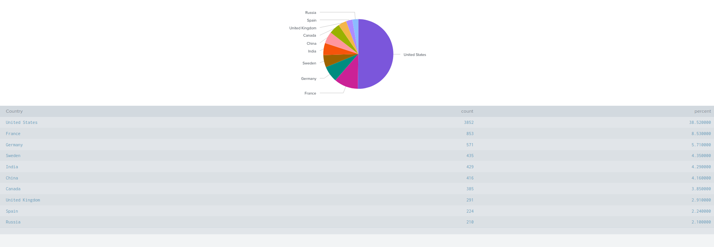
Dashboards—Apache
Top 10 Countries

Slide 18
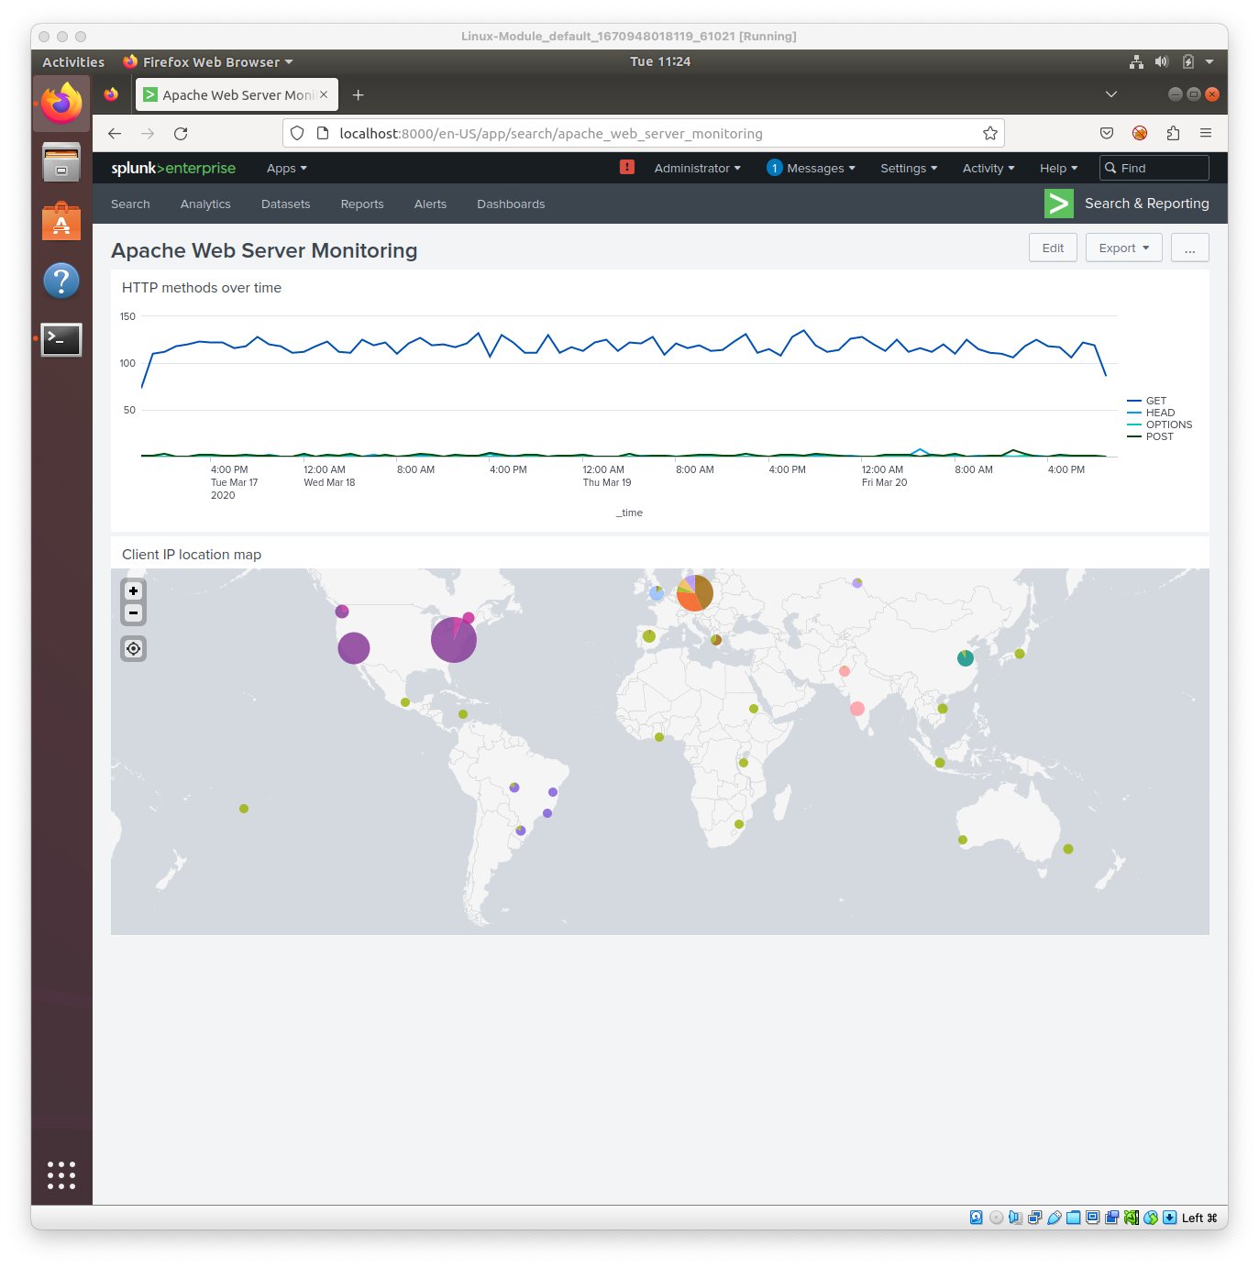
Dashboards—Apache
Client IP Location Map

Slide 19
Dashboards—Apache
HTTP Methods Over Time

Slide 20
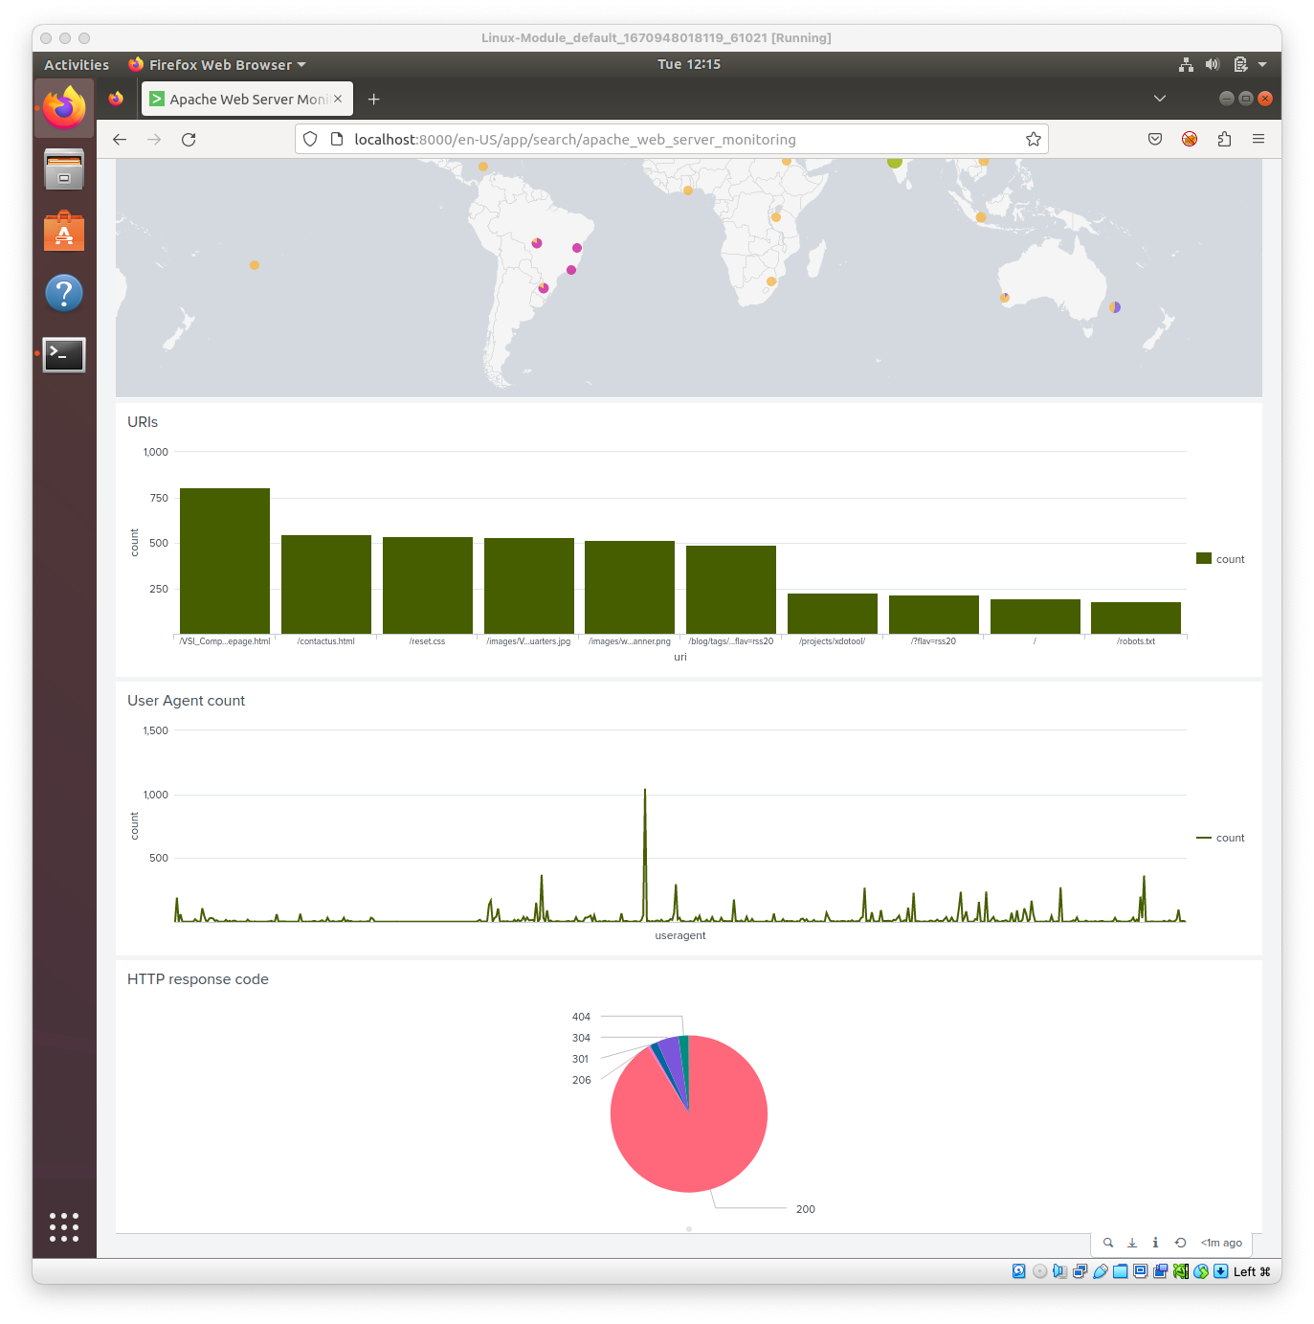
Dashboards—Apache
HTTP Response Code

Slide 21
Dashboards—Apache
URIs

Slide 22
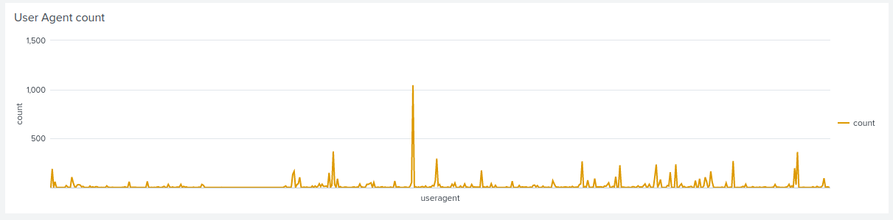
Dashboards—Apache
User Agent Count

Slide 23
Attack Analysis
‹#›
Notes:
Chris, Martin

Slide 24
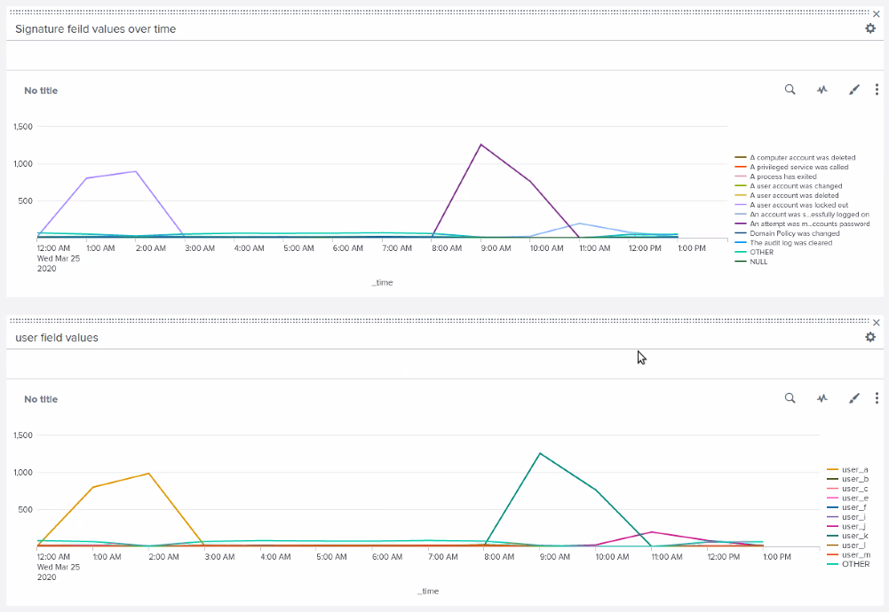
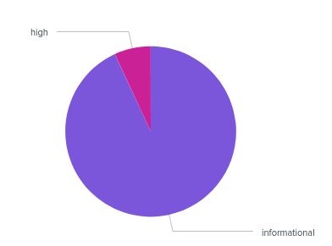
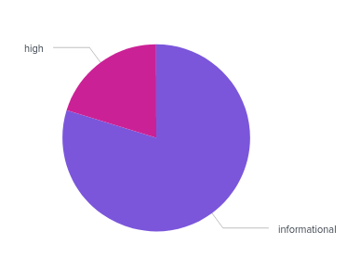
Attack Summary—Windows
We will now detail our findings from our reports when analyzing the Windows attack logs in Splunk.
There were two separate attacks which occurred on March 25. (right image)
The first attack happened between 12am and 3am
The second attack over the hours of 8am to 11am.
High Severity Alerts on March 25th increased by 13.7% to 20.2% on the Attack Log (below)
Notes:
Chris

Slide 25
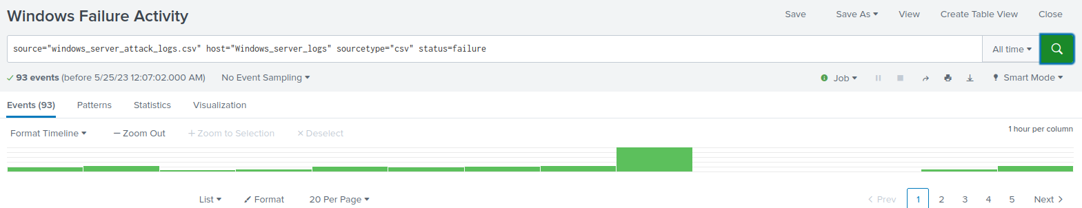
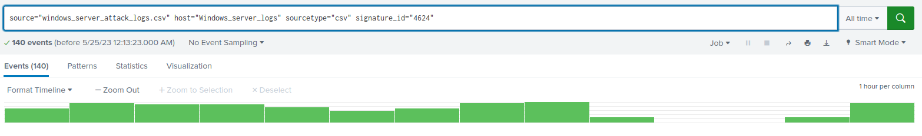
Attack Summary—Windows
Failure Alerts
We noticed a heavy increase at 8AM then a dramatic decrease to no activity from 9-11AM.
We set our threshold to 25 which triggered an alert to our team with 35 events.
Success logged on Alert
Our team saw no activity from 10-11AM.
Our team did not receive alert would not of been triggered since we did not think a point of interest would be it hitting 0.
Notes:
Chris

Slide 26
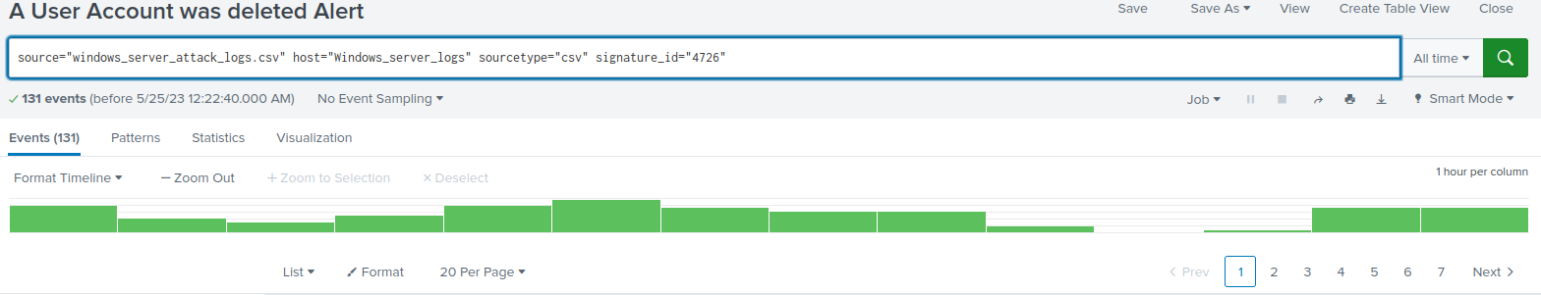
Attack Summary—Windows
Summarize your findings from your alerts when analyzing the attack logs. Were the thresholds correct?
Deleted Accounts Alert
Just like the Successful log in alert there is a significant dip in activity from 9-11am.
For that same reasoning as well our alert would not have triggered
Notes:
Chris

Slide 27
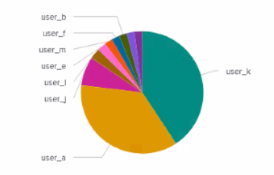
Attack Summary—Windows
Our findings from our dashboards when analyzing the attack logs:
Details of the two separate attacks which occurred on March 25:
The first attack happened between 12am and 3am from the UserA account, which resulted in the account being locked out at 2am
Lock Out signatures peaked at 896
Baseline Failures is 10 per hour, at 8am logs show 35, triggering an alert to the team.
The second attack utilized UserK, with attempts to change the password to the account over the hours of 8am to 11am. There were over 1000 attempts to change the password in that timeframe. The peak count of the signatures was 1256.
Notes:
Chris

Slide 28
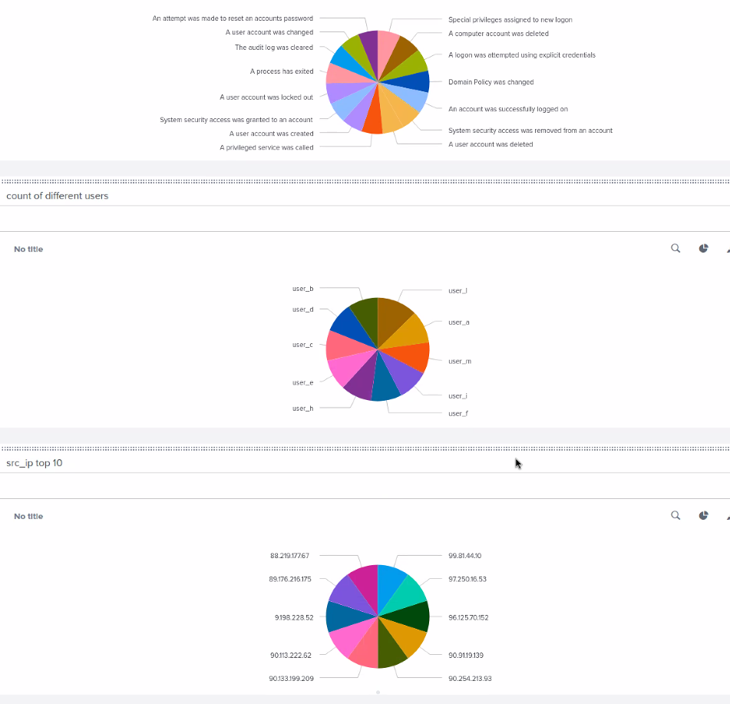
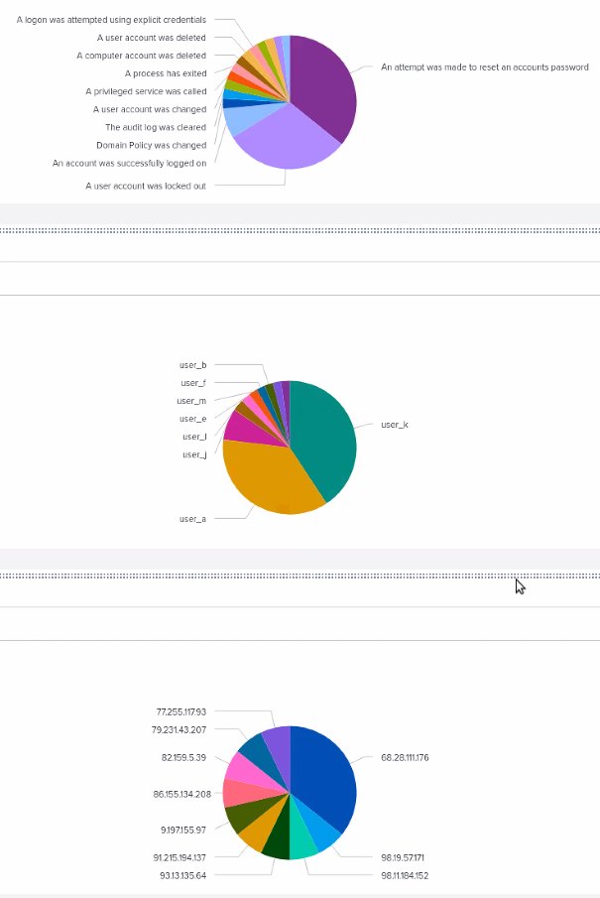
Attack Summary—Windows
Normal Activity
Attack Activity

Slide 29
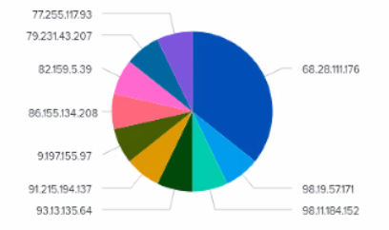
Attack Summary - Windows
A report of Top 10 IPs alerted our team to an abundance of activity from the specific IP of 68.28.111.176
Between 9am and 10am there were near zero deleted accounts. Our team suspected a DDOS attack was underway after the activity that began at 8am.

Slide 30
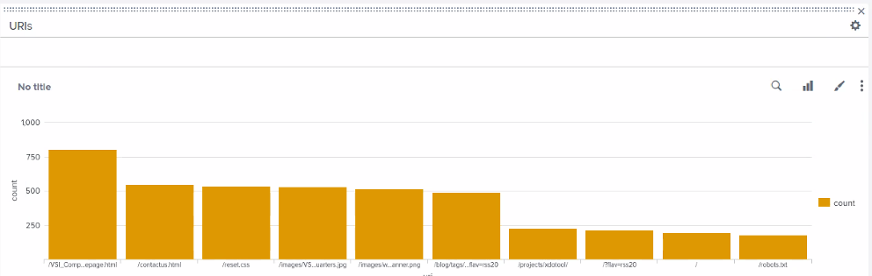
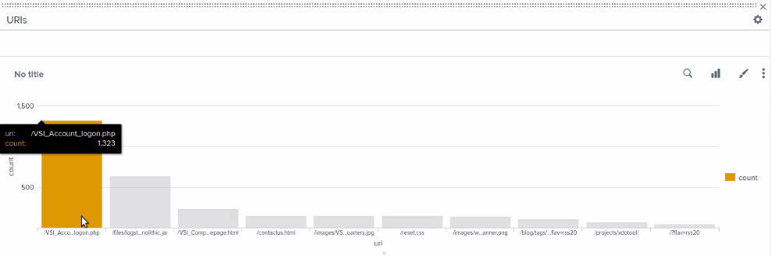
Attack Summary— Apache URI Analysis
Moving to Apache Log Analysis, we begin with our URI analysis.
Our Splunk reports show VSI_Account_logon.php with a count of 1,323 was the primary vector of the attack.
Based upon this, it reinforces our belief a DDOS attack was being induced. This also explains the no activity in the reports before this from the times of 9-11 AM.

Slide 31
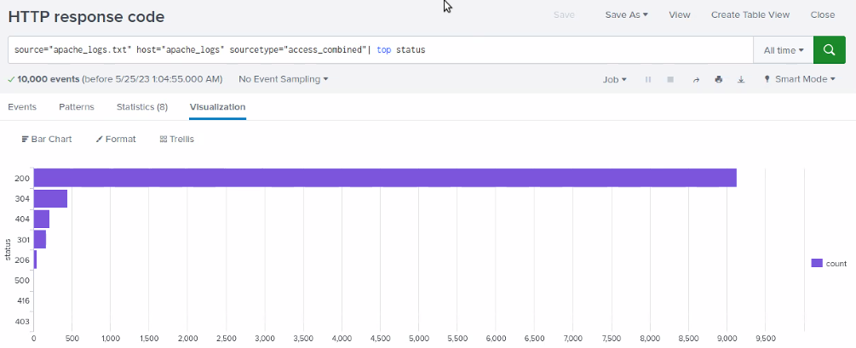
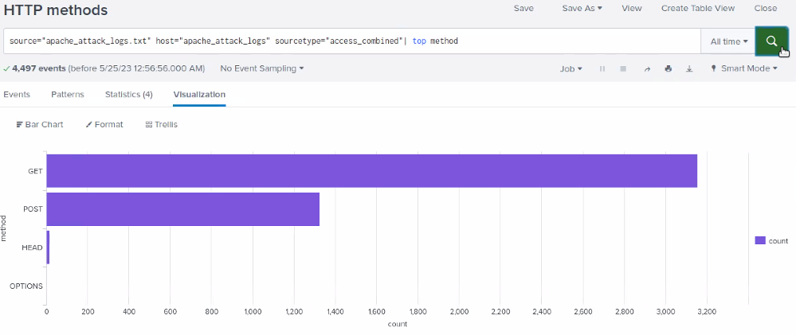
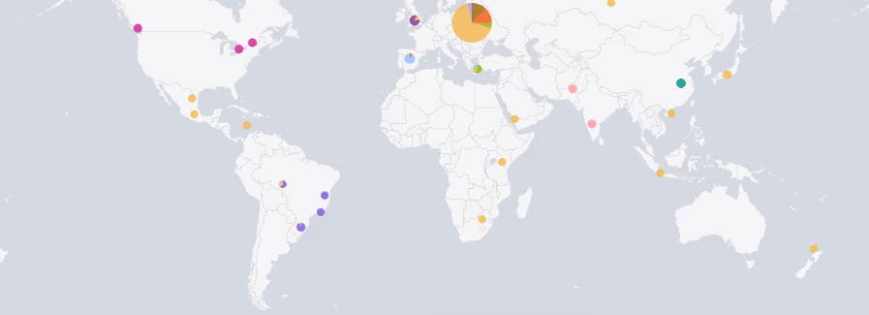
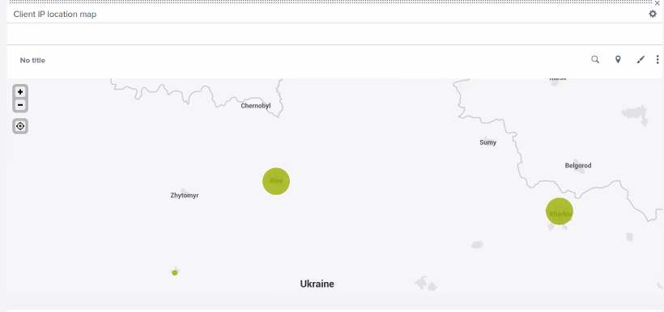
Attack Summary— Apache
As the Image shows, there was a DRAMATIC increase in POST requests
As well as the map shows us where all these request’s were coming from, which we discovered to be the originating from Ukraine, specifically from Kiev and Kharkiv equally.
Our Threshold barley wouldn’t of been hit for a certain countries request we found that it peaked just under 900 which was our threshold.
We did say we would change our threshold from 900 -> 800

Slide 32
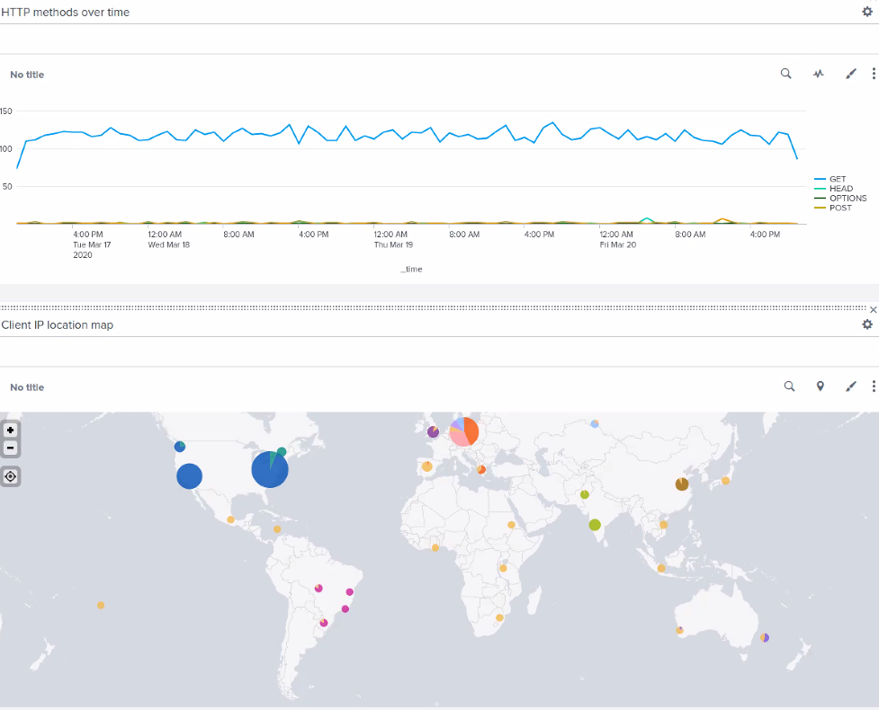
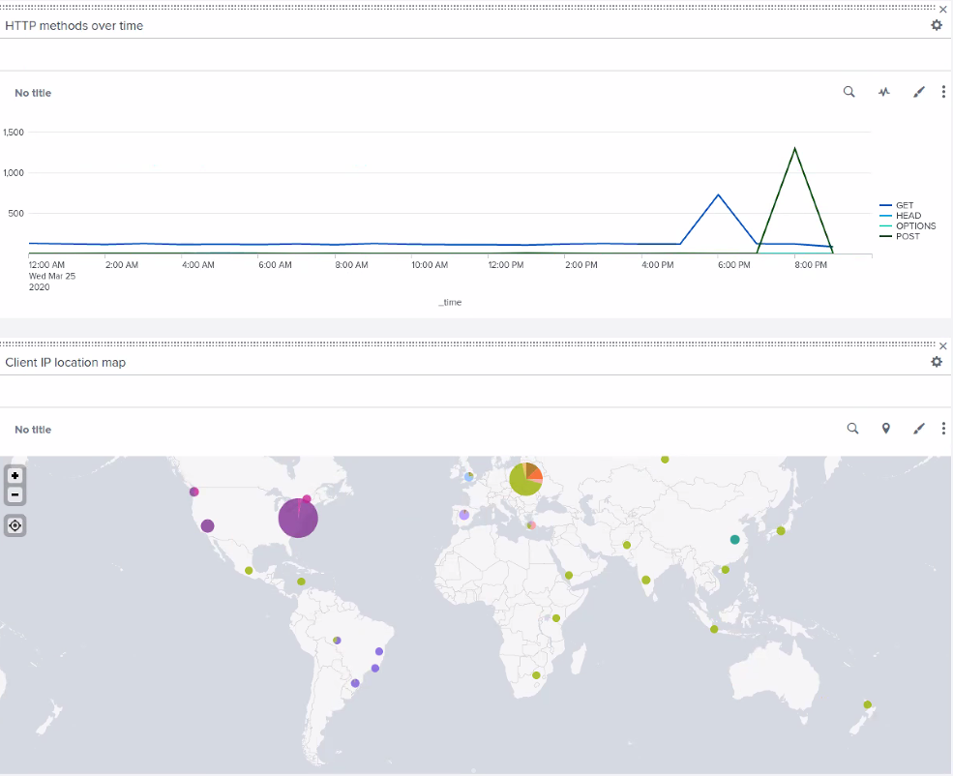
Attack Summary— Apache Screenshots
These dashboard images show normal HTTP activity in the time leading up to the attack. At 6pm our team sees a spike in GET commands, and 2 hours later at 8pm a spike in POST commands.
Before Attack During Attack

Slide 33
Summary and Future Mitigations
‹#›
Notes:
Fernando

Slide 34
Project 3 Summary
The attack on the windows server had some interesting account activity
The timeline
There were many suspicious pings on the alerts and report we made for the exercise, specifically around the times of 00:00 - 03:00 and 08:00 - 11:00
A lot of these pings were associated with account credentials and accounts of interest are the following: user_a, user_k, and user_j
This is all really suspicious activity that leads me to believe someone used some sort of brute force technique to potentially flood the requests
Notes:
Timeline of attack: User A was sending out locked out pings between midnight and 3 am
but user K produced high severity spikes for attempting to change password around 8am to 11am, there was also a spike of windows failure around the time user K was attempting to reset their password
and shortly after that range user J soon was logged in many times successfully

Slide 35
Project 3 Summary
The interesting pings we got from the apache server really came from the HTTP requests
The was a huge spike of POST and GET requests coming from two major cities in Ukraine
There was also a spike on the login page, the URI path graph, but there was also a huge decrease in activity on the web app overall
Tying in with the decrease in activity of the web app, there was an increase of 404 errors, which leads me to believe this attack data has to be from a DDOS attack
Notes:
The timeline: At seven we had an increase of GET requests around 6 pm and even a greater increase of post 8 pm
At the same time post was getting an increase, the login page got the same amount of traffic
the increase of 404 status’ was around 6 pm

Slide 36
Project 3 Summary
For the windows server, I would recommend accessing password policy
One user should not be able to make 1000 attempts to reset a password within a span of a couple of hours
We could change some of the password policy similar to a standard set by windows “a threshold of 10 bad attempts, a 15 minute lockout duration, and counter reset after 15 minutes (10/15/15)” -Windows techcommunity page
For the apache server, I would increase redundancies to alleviate downtime on the server.
One example that I would like to mention is load balancers across multiple servers depending on how much of VSI’s resources we are willing to allocate
Another mitigation strategy is setting a limit the amount of traffic able to get through per hour
Notes:
For research on the DDOS on the apache server mitigation https://www.indusface.com/blog/best-practices-to-prevent-ddos-attacks/#:~:text=Rate%20limiting%20can%20be%20implemented,lead%20to%20a%20DDoS%20attack.

